Slide 1


Slide 2

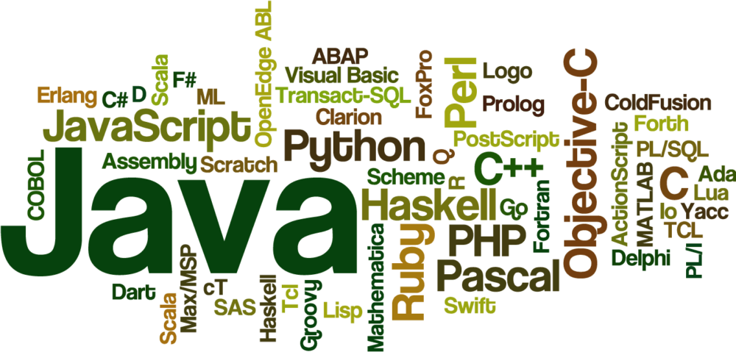


Slide 3



EXCEPTION HANDLING
IN
JAVA

Slide 4
JAVA EXCEPTION HANDLING
Exception Handling is the mechanism to handle runtime malfunctions
We need to handle such exceptions to prevent abrupt termination of program
A bunch of things can lead to exceptions, including programmer error, hardware failures, files that need to be opened cannot be found, resource exhaustion etc

Slide 5
JAVA EXCEPTION
A Java Exception is an object that describes the exception that occurs in a program
When an exceptional events occurs in java, an exception is said to be thrown
The code that's responsible for doing something about the exception is called an exception handler

Slide 6
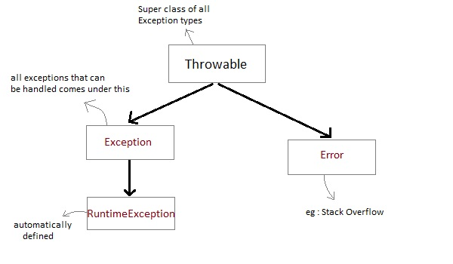
JAVA EXCEPTION CLASS HIERARCHY
All exception types are subclasses of class Throwable, which is at the top of exception class hierarchy

Slide 7
JAVA EXCEPTION CLASS HIERARCHY
Exception class is for exceptional conditions that program should catch. This class is extended to create user specific exception classes
RuntimeException is a subclass of Exception. Exceptions under this class are automatically defined for programs
Exceptions of type Error are used by the Java run-time system to indicate errors having to do with the run-time environment, itself. Stack overflow is an example of such an error

Slide 8
TYPES OF EXCEPTIONS
Checked Exception
Unchecked Exception
Error

Slide 9
CHECKED EXCEPTION
The exception that can be predicted by the programmer at the compile time
Example :
File that need to be opened is not found. These type of exceptions must be checked at compile time

Slide 10
UNCHECKED EXCEPTION
Unchecked exceptions are the class that extends RuntimeException
Unchecked exception are ignored at compile time
Example :
ArithmeticException, NullPointerException, Array Index out of Bound exception. Unchecked exceptions are checked at runtime

Slide 11
ERROR
Errors are typically ignored in code because you can rarely do anything about an error
Example :
if stack overflow occurs, an error will arise. This type of error cannot be handled in the code

Slide 12
UNCAUGHT EXCEPTIONS
When we don't handle the exceptions, they lead to unexpected program termination. Let’s take an example for better understanding
class UncaughtException { public static void main(String args[]) { int a = 0; int b = 7/a; // Divide by zero, will lead to exception } }

Slide 13
UNCAUGHT EXCEPTIONS
This will lead to an exception at runtime, hence the Java run-time system will construct an exception and then throw it
As we don't have any mechanism for handling exception in the above program
Hence the default handler will handle the exception and will print the details of the exception on the terminal

Slide 14
JAVA EXCEPTION HANDLING SAMPLE CODE
package com.myjava.exceptions; public class MyExceptionHandle { public static void main(String a[]){ try{ for(int i=5;i>=0;i--){ System.out.println(10/i); } } catch(Exception ex){ System.out.println("Exception Message: "+ex.getMessage()); ex.printStackTrace(); } System.out.println("After for loop..."); } }
OUTPUT: 2 2 3 5 10 Exception Message: / by zero java.lang.ArithmeticException: / by zero at com.myjava.exceptions.MyExceptionHandle.main(MyExceptionHandle.java:12) After for loop...

Slide 15

THANK YOU

